Slide 1


Introduction
to

Slide 2





Who am I
I’m Robert James Gabriel
I work as Developer
At .
Odd facts:
Turned down a phd scholarship. Hacked into my old school during finals,using a mobile phone and word clone.
I like algorithms, HCI design, Tabs over spaces.
RobertJGabriel
RobertJGabriel
robetgabriel.ninja

Slide 3
What is

Slide 4

What is firebase?
Is a NoSQL database.
Based on JSON.
Gives you the tools and infrastructure you need to build better apps and grow successful businesses.
Implementing is quick and easy.
With intuitive APIs packaged into a single SDK.

Slide 5
You can focus on solving your customers' problems and not waste time building complex infrastructure.

Slide 6
Where does firebase sit in your app?

Slide 7
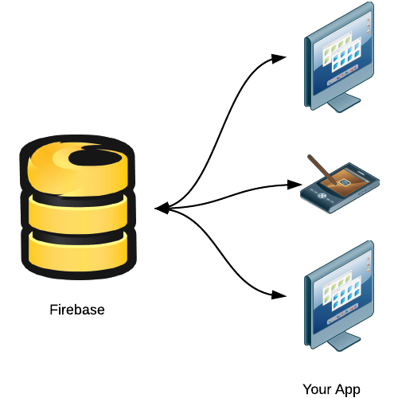
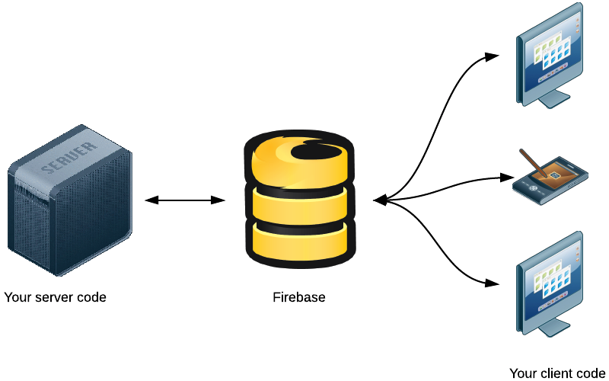
Where does firebase sit in your app?
Client side sever
Client Side

Slide 8
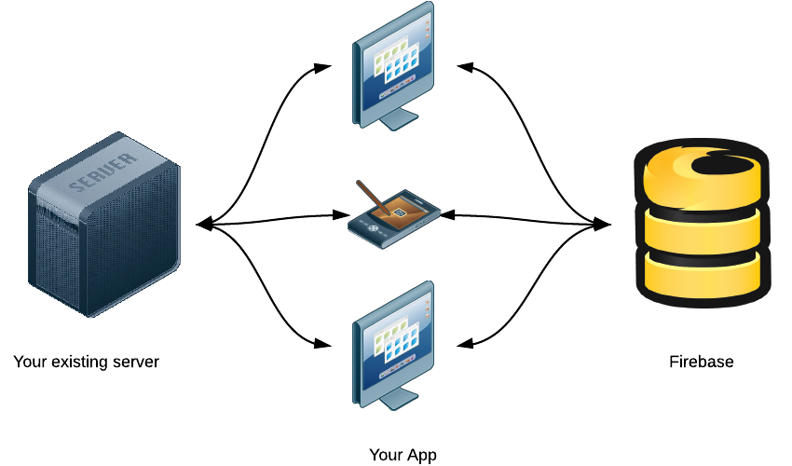
Where does firebase sit in your app?
Existing App

Slide 9
Works across platform

Slide 10
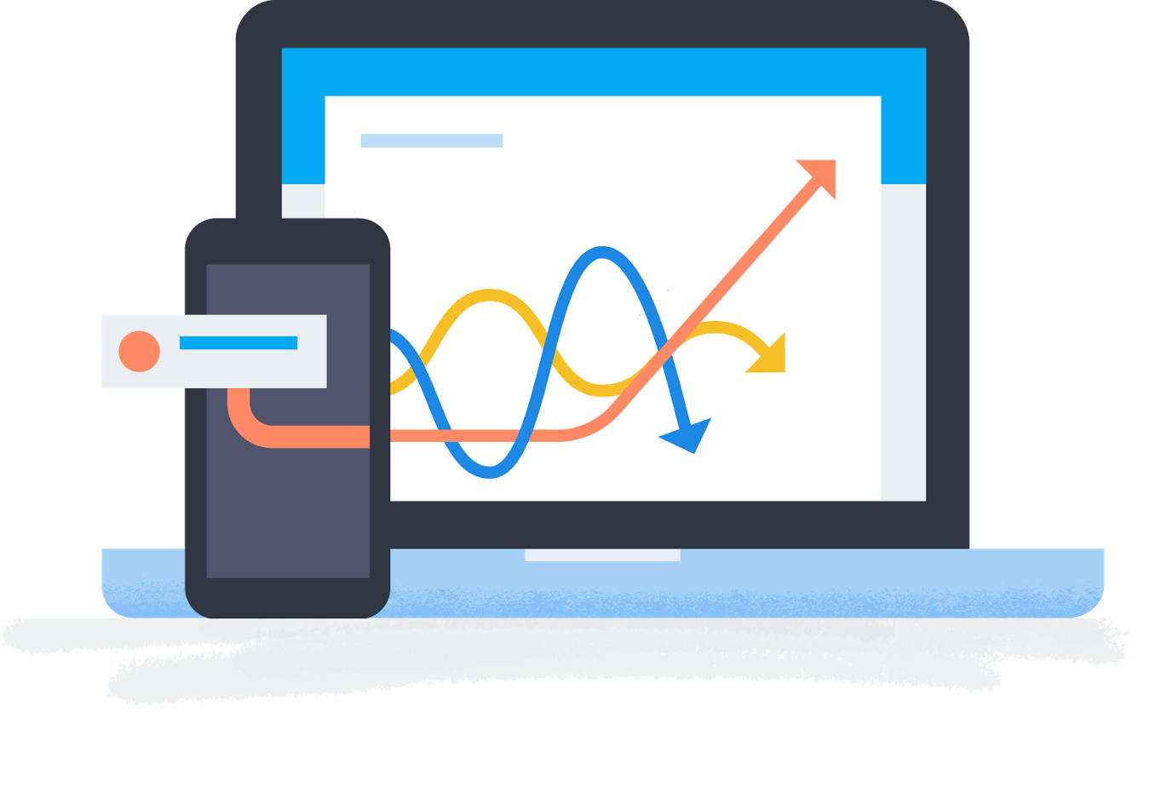
Works across platform
You can have one NoSQL database syncing across your in real time.
iOS
Android
JavaScript
C++.
Expand to a different platform without modifying your infrastructure.
Super easy to set up!

Slide 11
Code example
Javascript firebase.auth().onAuthStateChanged(function(user) {
if (user) {
// User is signed in
var email = user.email;
// ...
} else {
// User is not signed in
// ...
}
});
firebase.auth().signInWithEmailAndPassword(email, password);
JAVA FirebaseAuth auth = FirebaseAuth.getInstance();
auth.signInWithEmailAndPassword(email, password)
.addOnCompleteListener(new OnCompleteListener() {
@Override
public void onComplete(Task task) {
if (task.isSuccessful()) {
FirebaseUser user = task.getResult().getUser();
String email = user.getEmail();
// ...
}
}
});

Slide 12
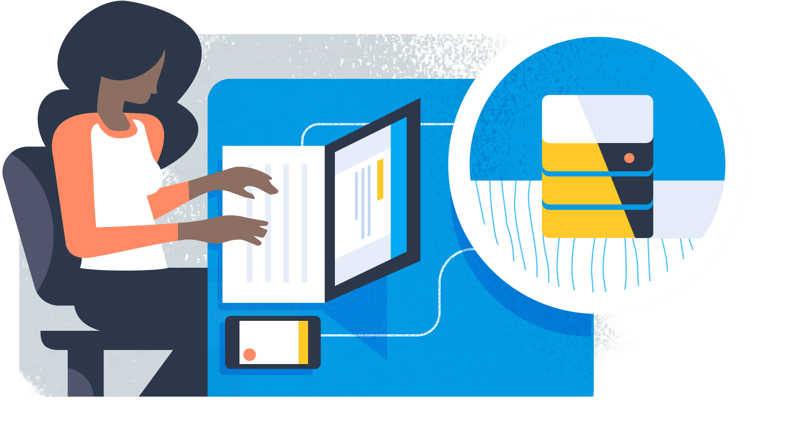
Live example
Going to create a basic signup/login
Android and a node program

Slide 13
Analytics

Slide 14
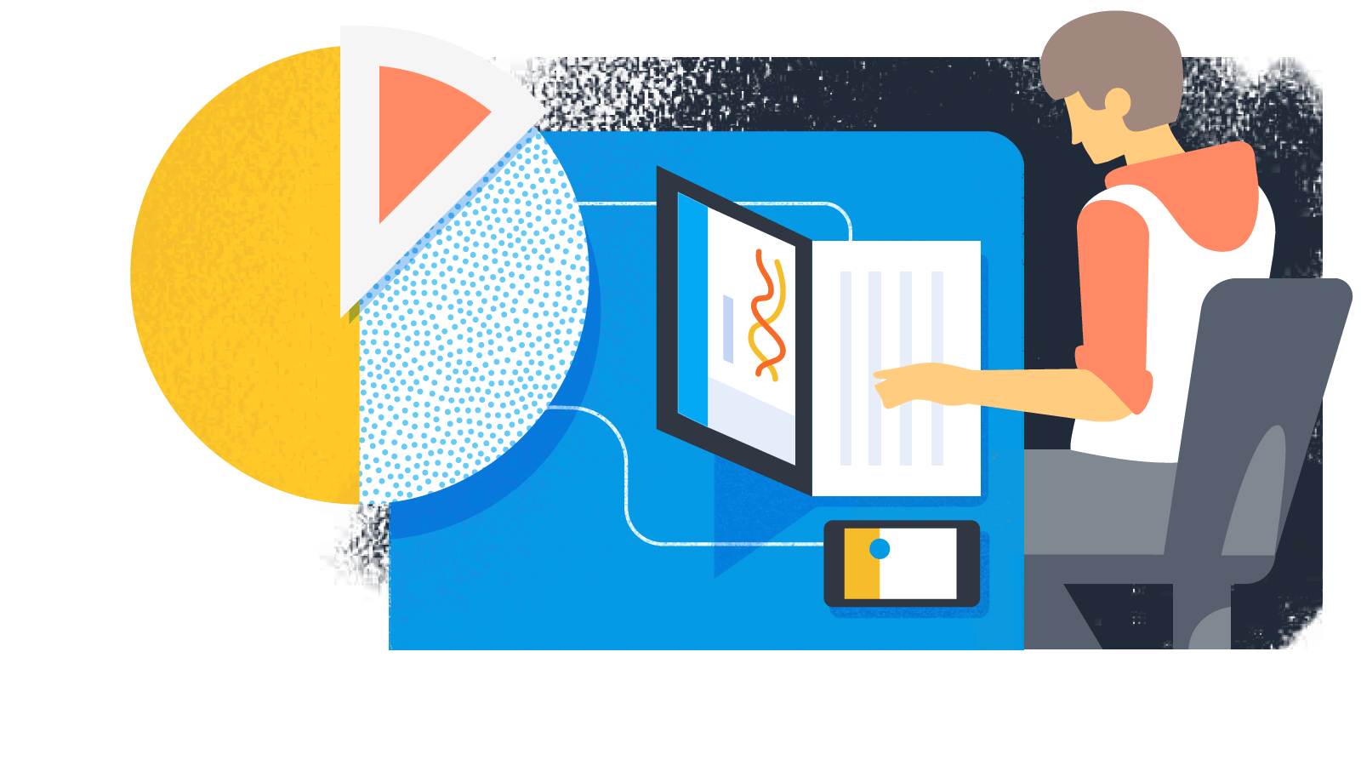
Firebase Analytics
Analytics in Firebase works with other Firebase features, so you can take action on everything from click-through rates to app crashes.
It helps you understand how people use your app.
You can set alerts and reports.

Slide 15
Live example
How to use Firebase Analytics and alerts

Slide 16
Other features

Slide 17

Other features
Cloud Messaging Deliver and receive messages across platforms reliably
Authentication Reduce friction with robust authentication
Realtime Database Store and sync app data in realtime
Storage Store files with ease
Hosting Deliver web content faster
Remote Config Customize your app on the fly
Cloud MessagingCloud Messaging Deliver and receive messages across platforms reliably
Deliver and receive messages across platforms reliably
Authentication
Reduce friction with robust authentication
Realtime Database
Store and sync app data in realtime
Storage
Store files with ease
Hosting
Deliver web content faster
Remote Config
Customize your app on the fly
Test Lab
Test in the lab, not on your users
Crash Reporting
Keep your app stable

Slide 18
Integrated/supported With Other Google Services

Slide 19
Firebase (NoSQL) vs MySQL

Slide 20
Firebase (NoSQL) vs MySQL
Pros Firebase is awesome for real time updates to data.
Powerful tools for managing authorization and access to that data.
Easy to scale
Cons Lacks searching and aggregation tools
Calculations on your data for Firebase need to be done on the client side after retrieving.

Slide 21
Thank you and Question Time

